Slide 1
Lahore
August 6th, 2018
In partnership with

Slide 2
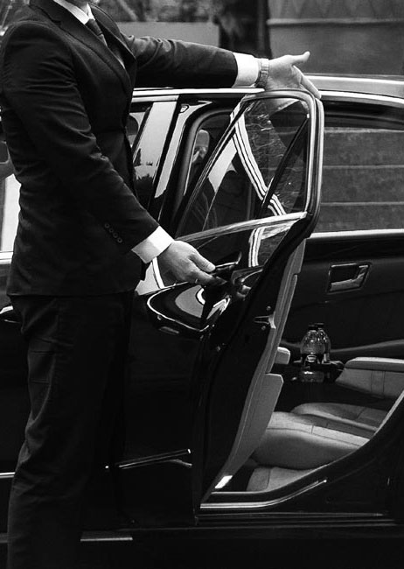
Agenda
Concept
Experience
Hosted Buyers programme

Slide 4
DUBAI

Slide 7
INTERNATIONAL

Slide 8
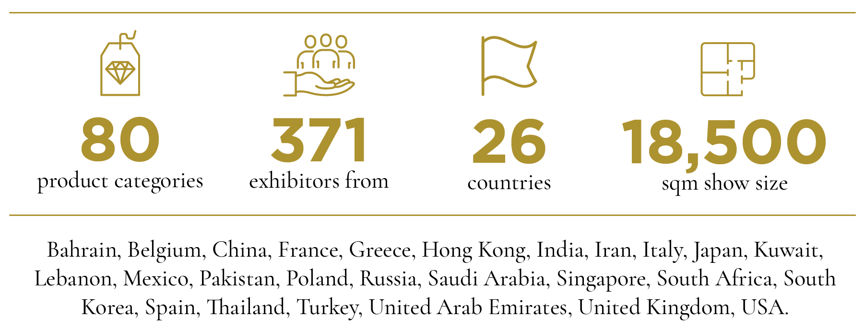
VOD Dubai International Jewellery Show

Slide 9
International visitors
Trade Visitors from over 80 different countries

Slide 10
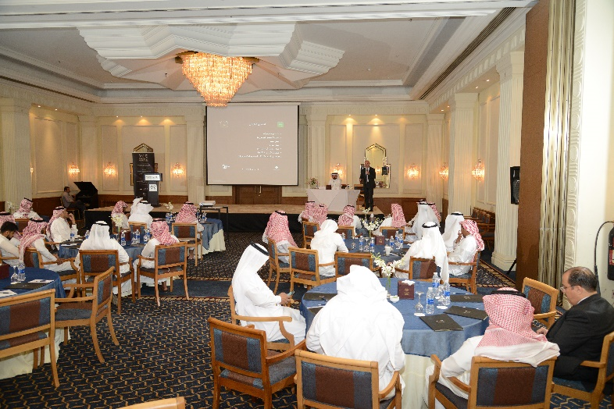
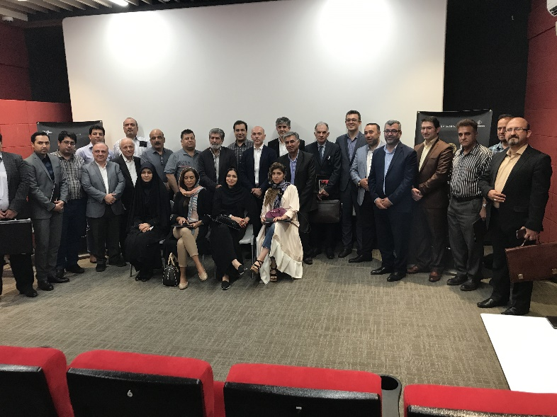
International promotion

Slide 11
JEWELLERY

Slide 12
PACKAGING &
TECHNOLOGY
GLOBAL BRANDS
FINE JEWELLERY
GEMSTONES &
DIAMONDS

Slide 13
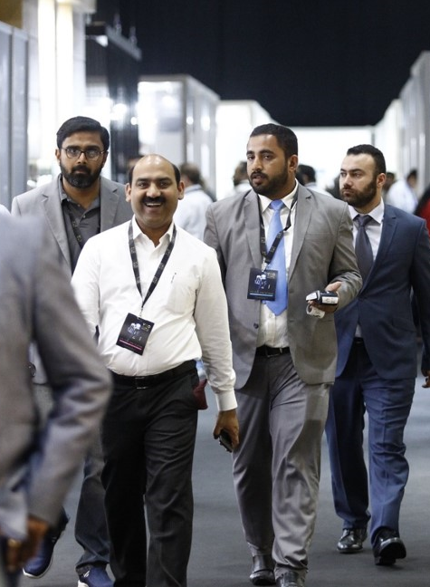
TRADE AREA
Manufacturers
Mounting companies
Wholesalers
Packaging and technology suppliers

Slide 14
Trade Area Experience
Dedicated fast track entrance
Welcome point
Relax lounge
Industry seminars and training sessions

Slide 15
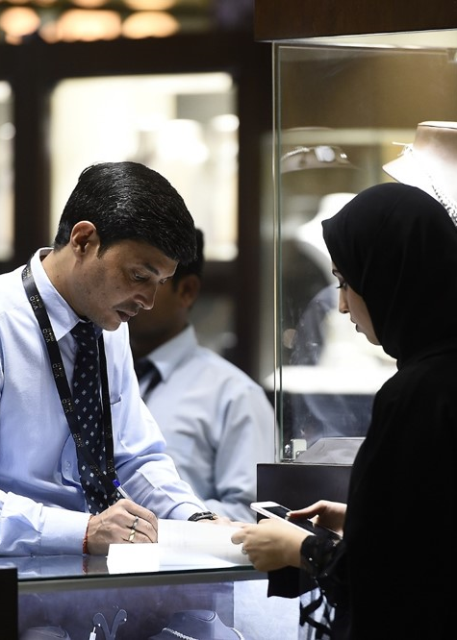
RETAIL & TRADE AREA
Retailers
Gemstones and diamonds traders
Other jewellery related business

Slide 16
Trade and Retail Area Experience
Dedicated entrance for ladies and VIP
Event arena with a rich programme of catwalks
Special VIP events
Awards and prize giving

Slide 17
SHOW

Slide 18
Experience

Slide 19
Here there will be the video

Slide 20
Venue Map

Slide 21
The floor plan
Entrance
Entrance
Entrance
Trade Entrance
Event Arena
Buyers Lounge

Slide 22
Premium And Hosted Buyers Program

Slide 23
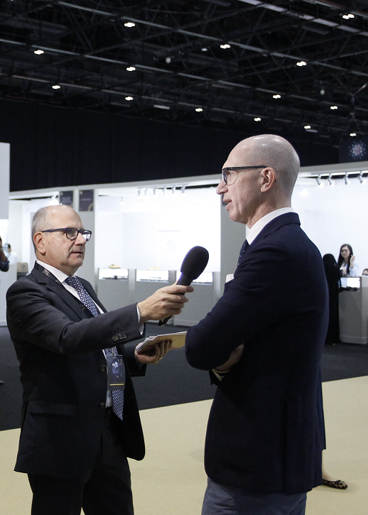
The show was really excellent this year and even if the business is weak now I got some very good new contacts
Hani Al Attar Kuwait Tiber Jewelers - Kuwait
It was really excellent to be among the top brands of the trade
Mr. Zahid Amir, Gold and Gold Craft - Pakistan
Thank you so much for this experience. It really surprised me to find so many international exhibitors here
Balaram Gopalan, Devji Aurum Gold & Diamond Factory - Bahrain

Slide 24
Benefits overview
 | Trade Visitors | Premium Buyers | Hosted Buyers
Visa assistance | X | X | V
5* Hotel accommodation | X | X | V
Shuttle service | X | V | V
Personal onsite assistance | X | V | V
Wi Fi | X | V | V
Dedicated lounge | X | V | V
Matchmaking program | X | V | V

Slide 25
The Business Matchmaking Program
Exhibitors and buyers
Participants can:
view the profiles
select the participants
manage invitations

Slide 26
Selection Criteria
Company profile
Priority of the country
Acceptance of being part of the matchmaking program

Slide 27
How to apply

Slide 28
Regional Advisor
For any enquiry during the year please refer to our official Regional Advisor for Pakistan
Gold & Gems Art Promotion Council of Pakistan,
Muhammad Ahmad, President
Cell: +92 333-4247276 or 300-4111729
Email: president@ggapcpakistan.com

Slide 29
Concept
Experience
Hosted Buyers programme

Slide 30
and see you in Dubai!
Thank you for your attention...

